Slide 1
PULSE
Our project read the heartbeat using a non-invasive sensor called Pulsometer. The data measured by the sensor are sent by the YUN to our website. Pulse was created to let users control their health.
In the future we wish to replace Pulse website with an app who can send patients data to their family doctor and if there are any anomalies calls the hospital. Our purpose is enforce computers to reduce the time for making diagnosis.

Slide 2
PULSE
What?
Pulse can read heartbeat with sensors and send it to our website.
Who?
People who have heart issues can use Pulse to control their health.
Why?
Our objective is to support people who have heart issues.

Slide 3
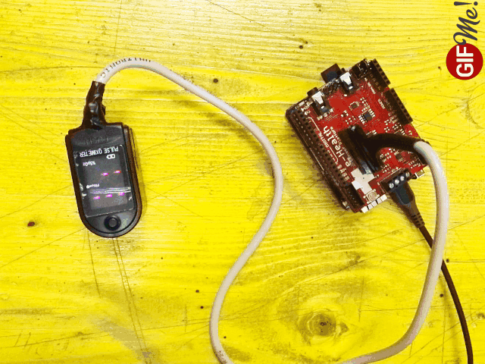
PULSE

Slide 4
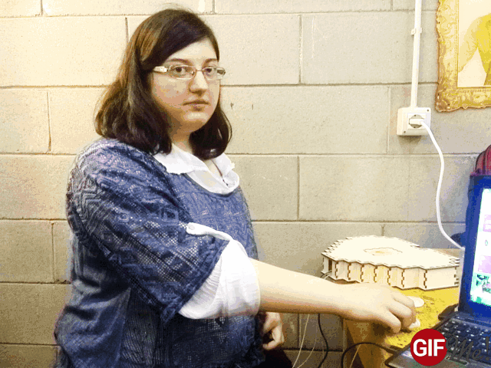
PULSE

Slide 5
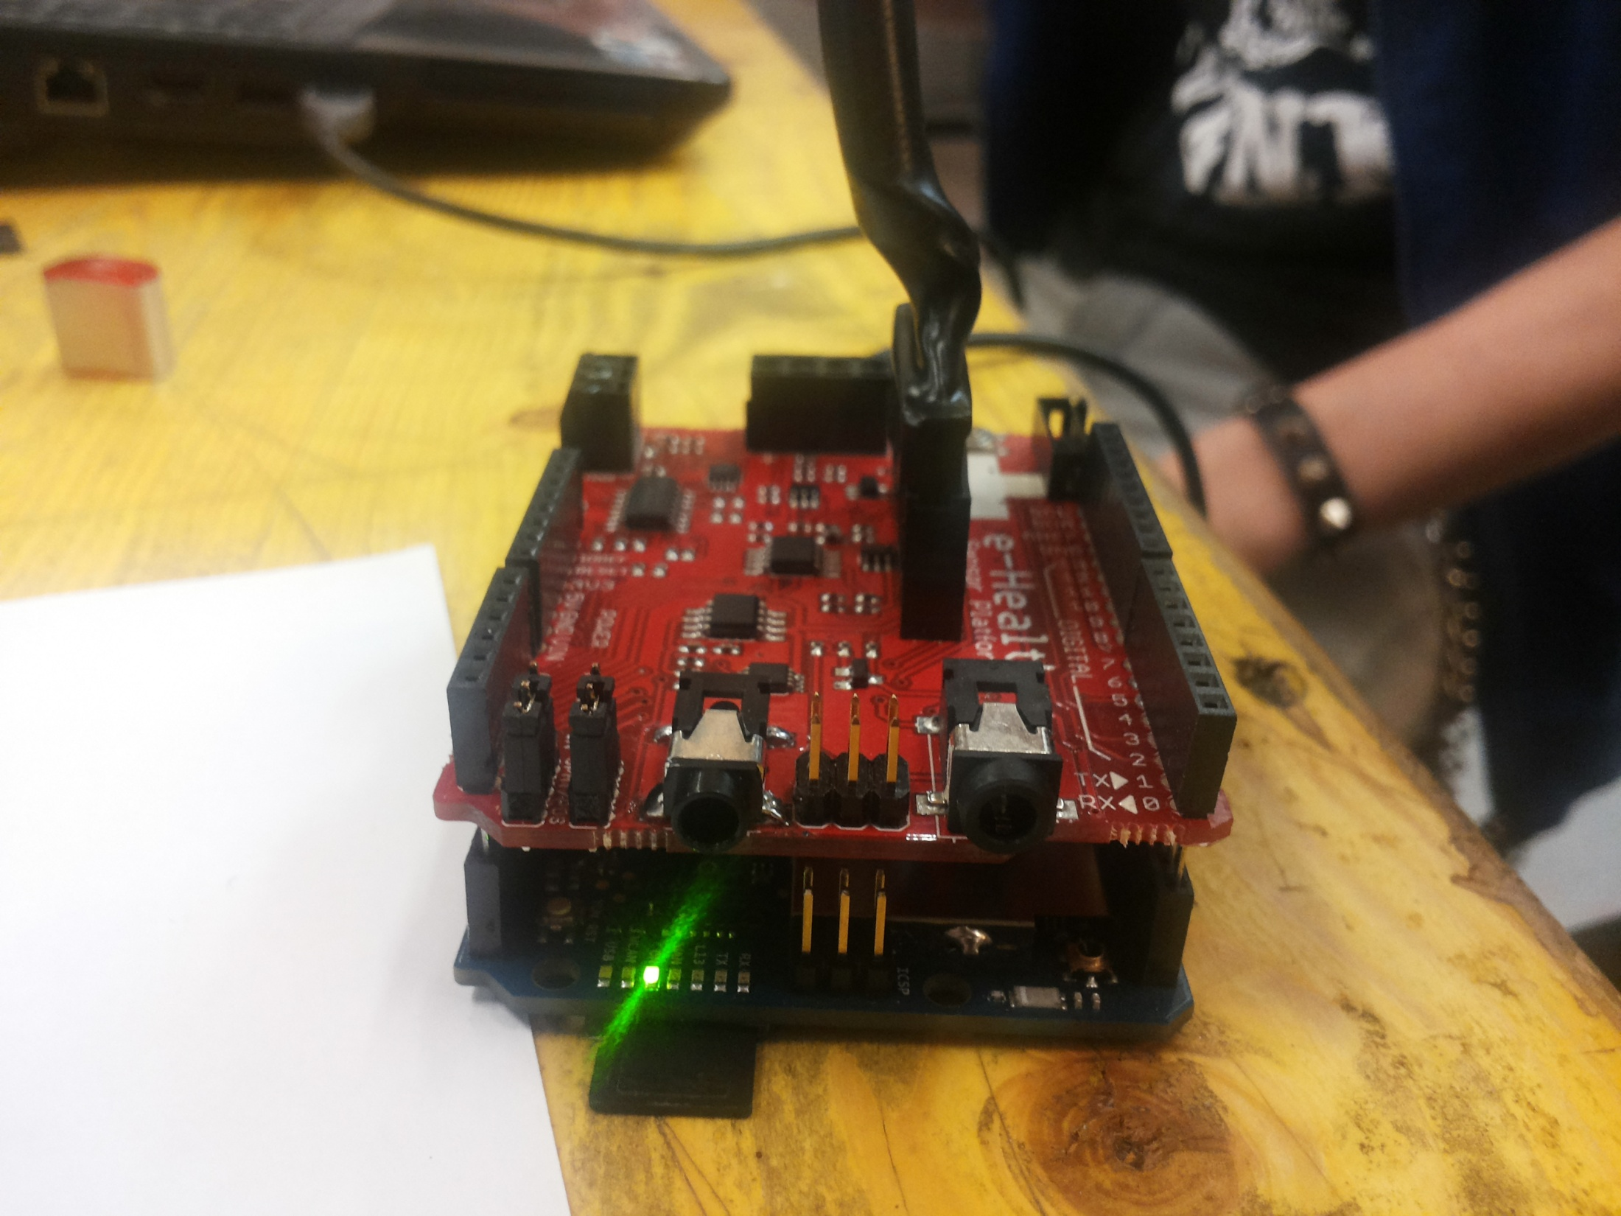
PULSE

Slide 6
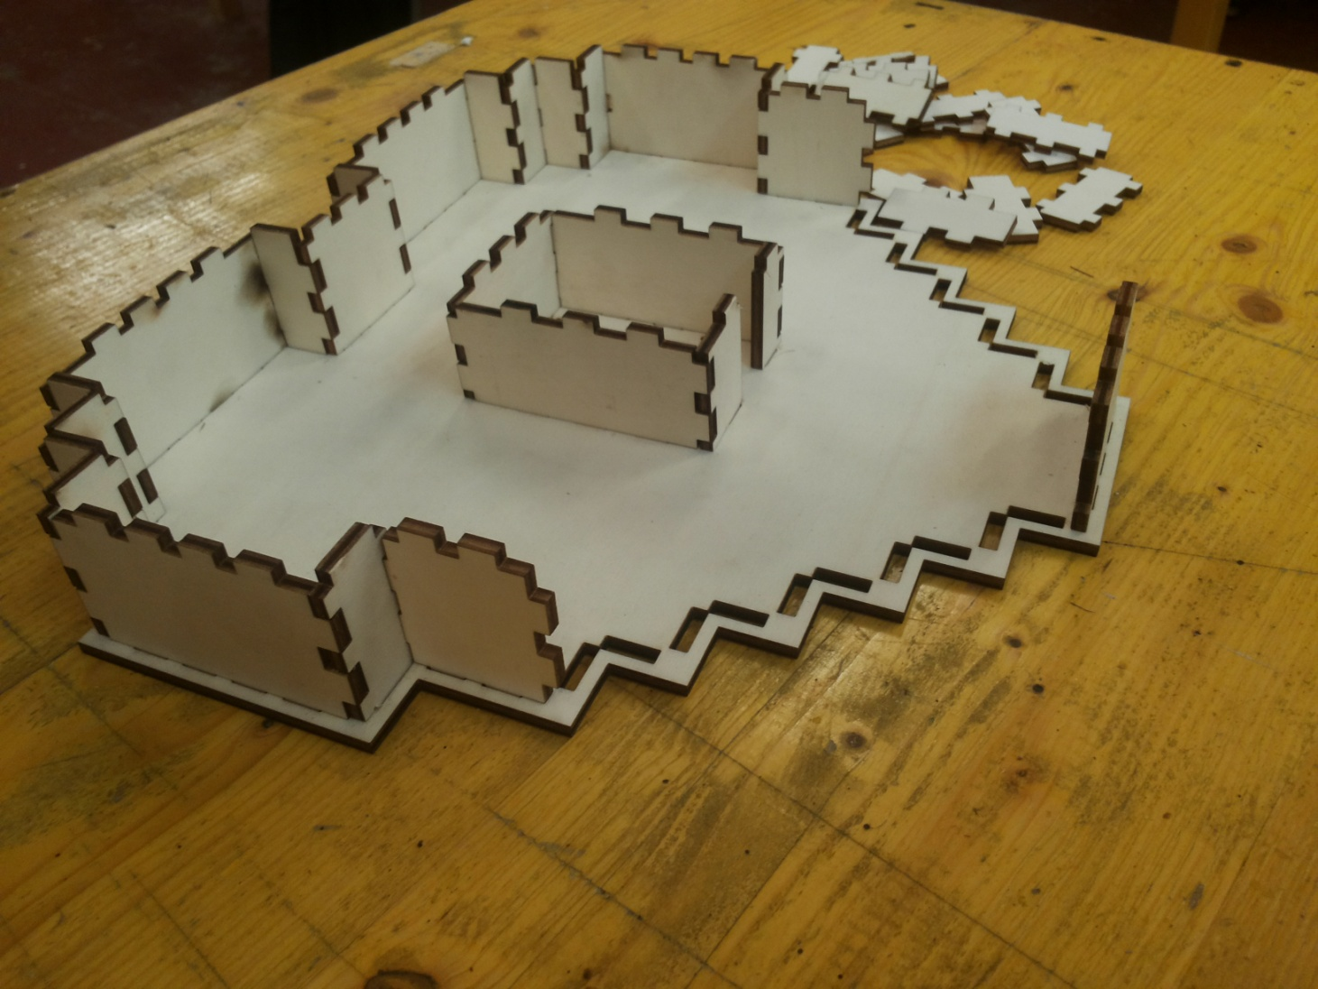
PULSE

Slide 7

PULSE

Slide 8
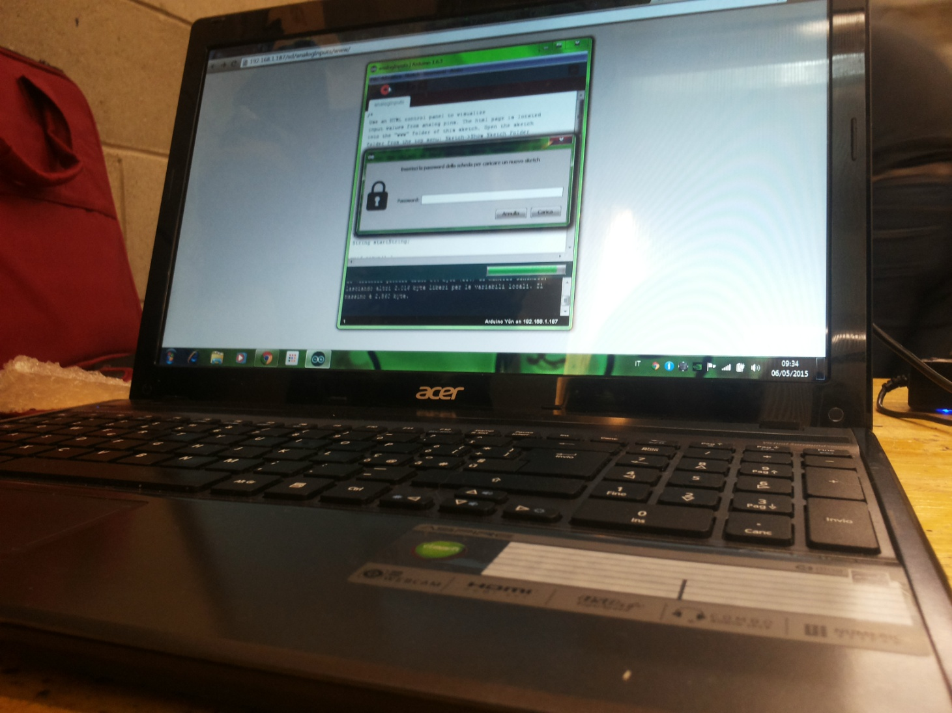
PULSE

Slide 9
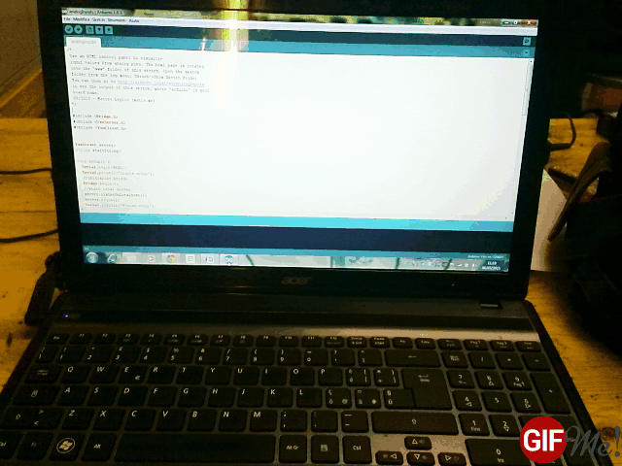
PULSE

Slide 10
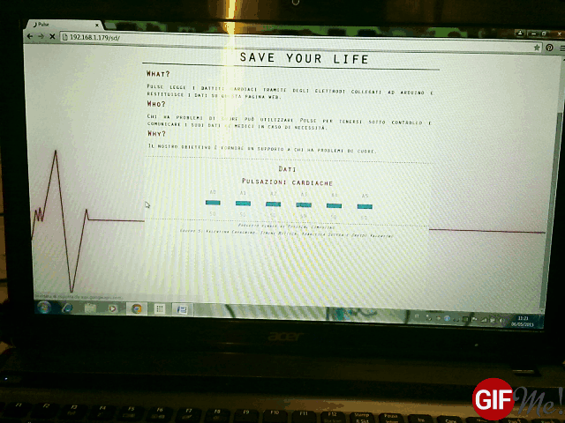
PULSE

Slide 11
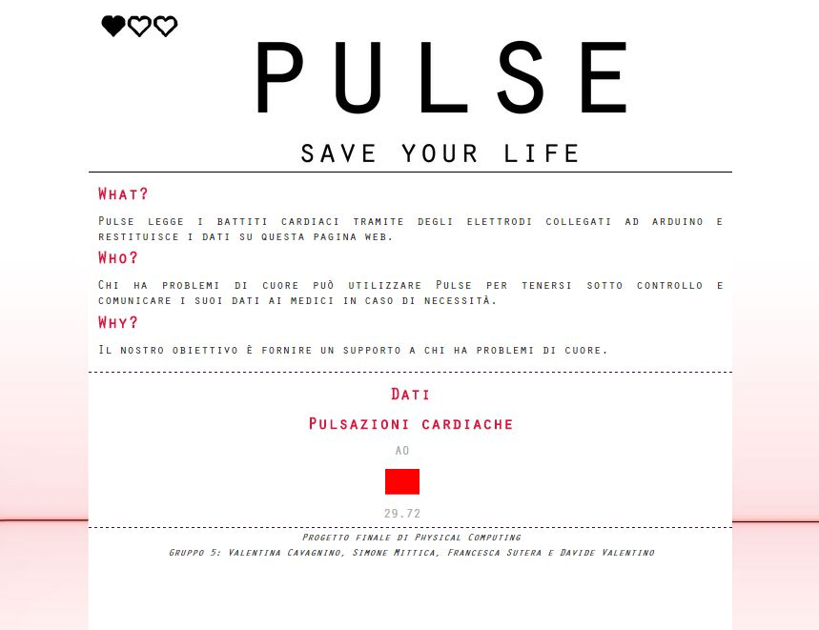

Slide 12
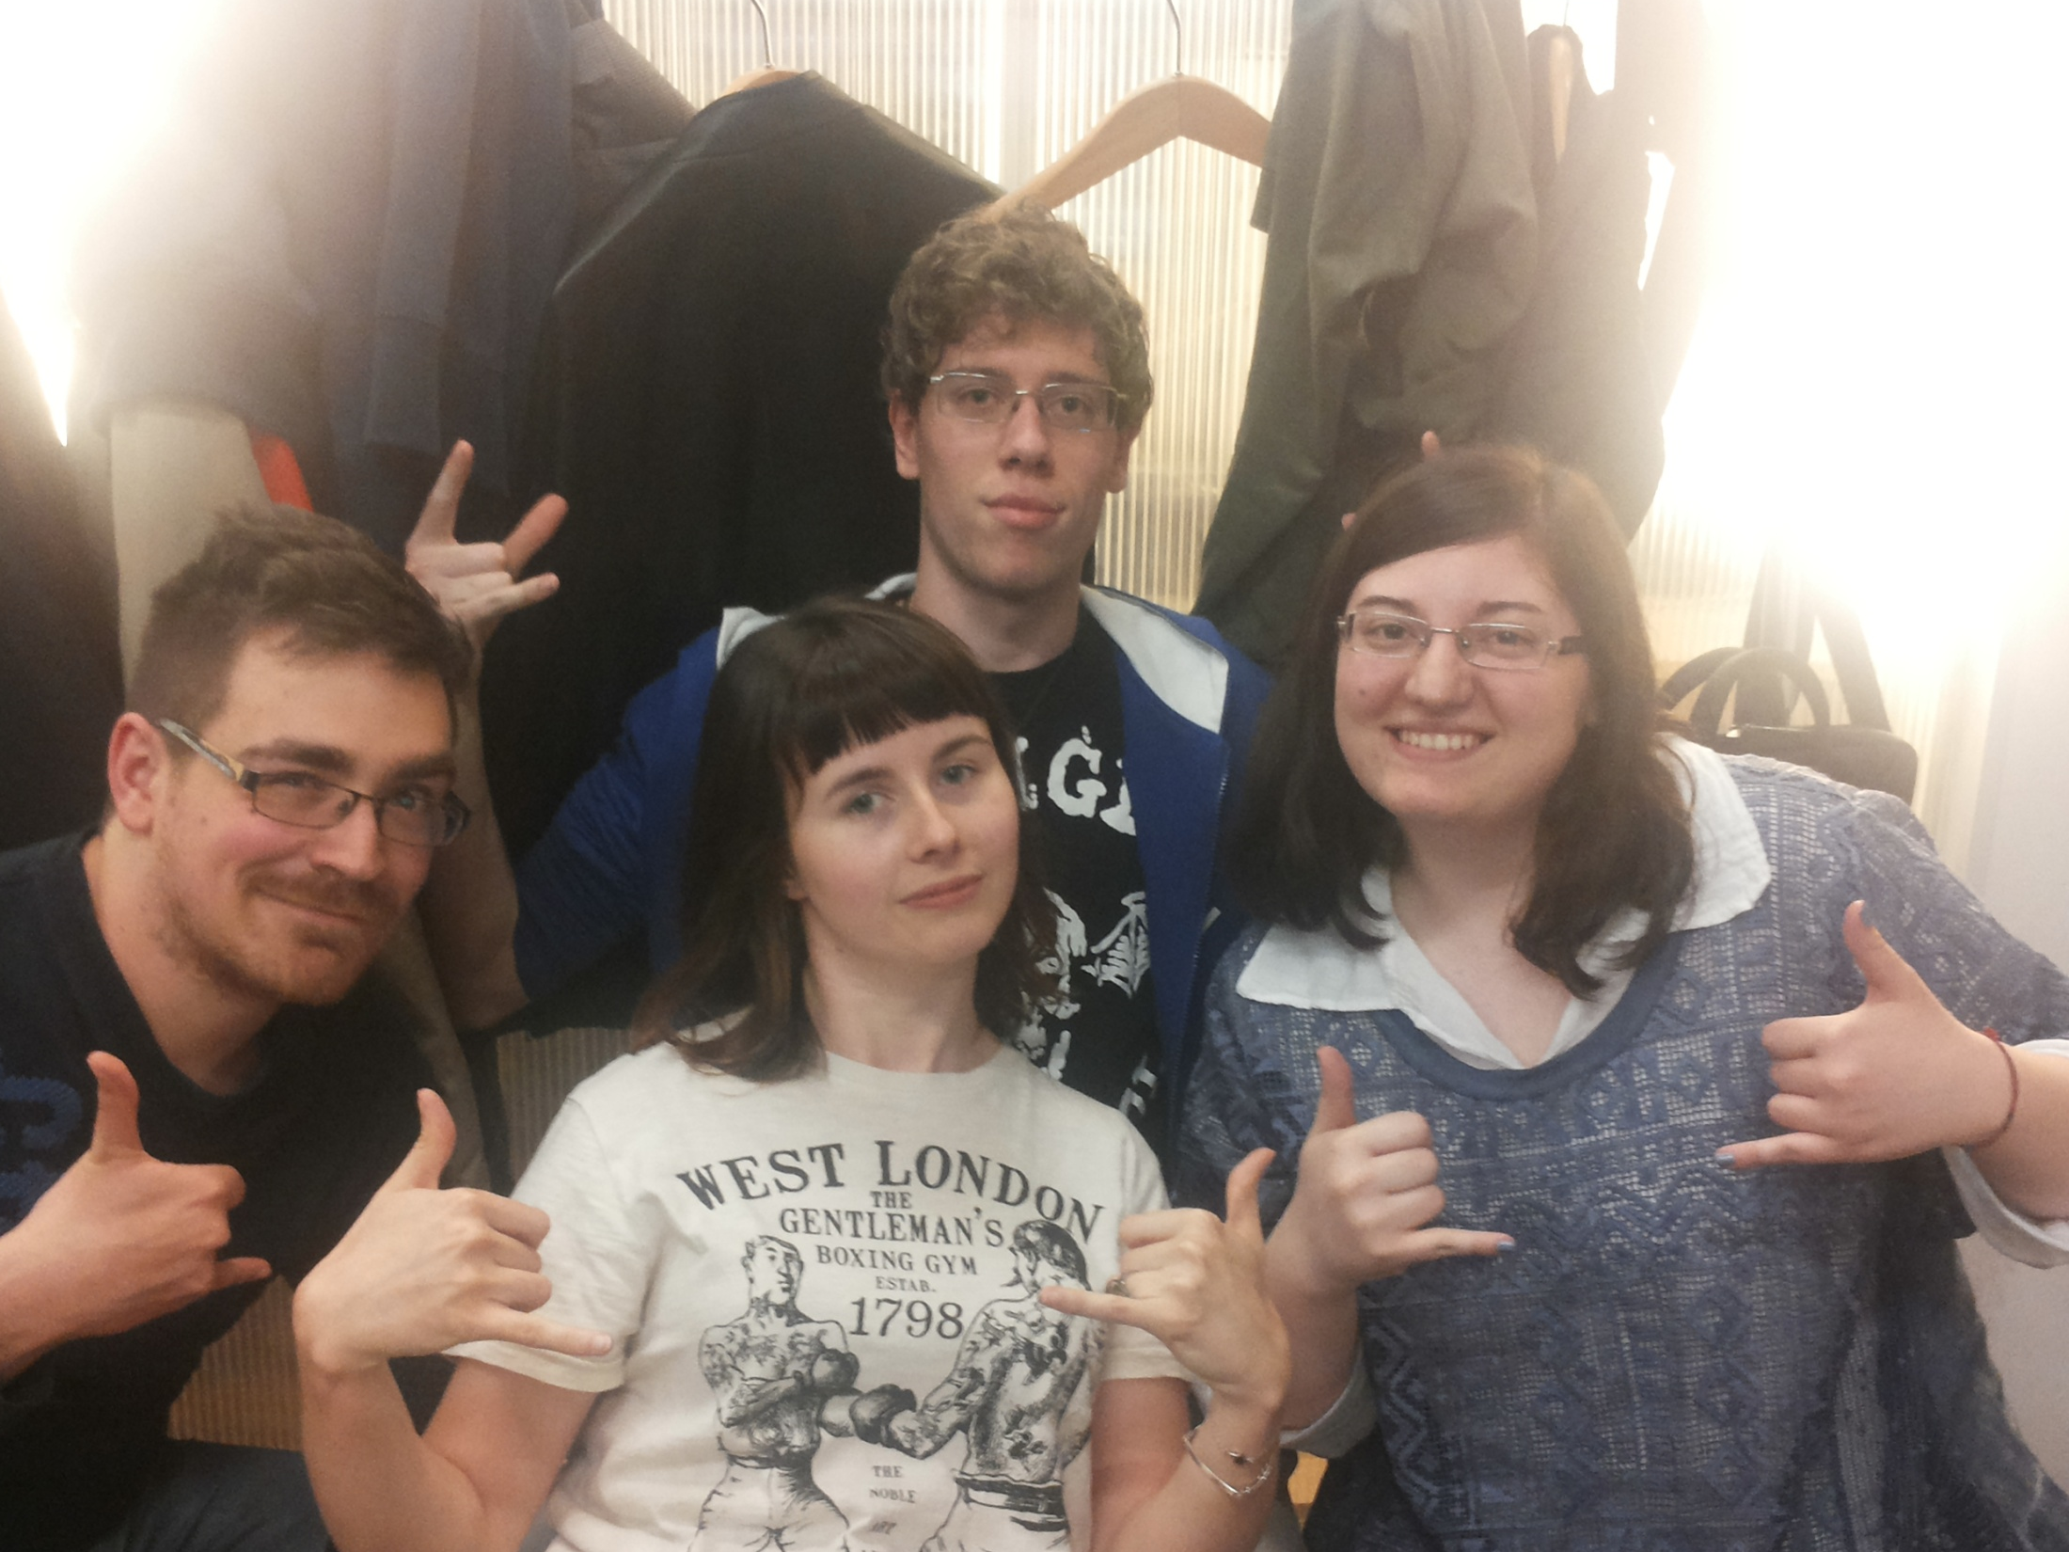
PULSE

